Slide 1

To Find out best Italian restaurant with help of Zomato data in the city of New Delhi

Slide 2
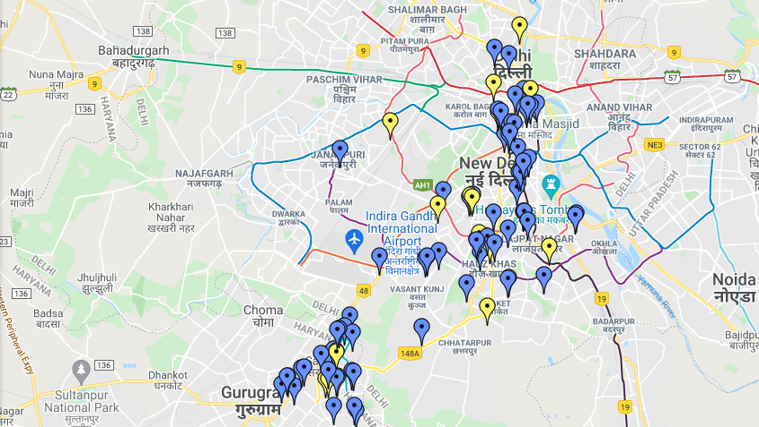
New Delhi Restaurants Map

Slide 3
Introduction
New Delhi is the capital city of India. It is a part of the city of Delhi’s 11 districts. The city itself has a population of 11 million. However, the much larger metro area has a population that exceeds 30 million.
With it’s diverse culture, comes diverse food items. There are many restaurants in New Delhi City, each belonging to different categories like Chinese, Italian, French etc .
Many people from different cities and countries are coming to Delhi for business and for tour. This data will help them to find best restaurants of their choice and locality to stay nearby of favorite food restaurants.

Slide 4
Purpose of the analysis
This data analysis will help people who are looking and trying to taste different foods in New Delhi. New Delhi is famous for its street food and special kind of local food. It also has many famous and multi-cuisines restaurants.
Many people from different cities and countries are coming to Delhi for business and for tour. This data will help them to find best restaurants of their choice and locality to stay nearby of favorite food restaurants.

Slide 5
Data References
New Delhi Restaurants data that contains list Locality, Restaurant name, Rating along with their latitude and longitude.
Data source : Zomato kaggel dataset
Description : This data set contains the required information. And we will use this data set to explore various locality of New Delhi city.
Nearby places in each locality of New Delhi city.
Data source : Fousquare API
Description : By using this API we will get all the venues in each neighborhood.

Slide 6
Methodology
Collect the New Delhi city data from Zomato kaggel dataset
Using FourSquare API we will find all venues for each neighborhood.
Filter out all venues that are nearby by locality.
Using aggregative rating for each restaurant to find the best places.
Visualize the Ranking of neighborhoods using folium library(python)

Slide 7
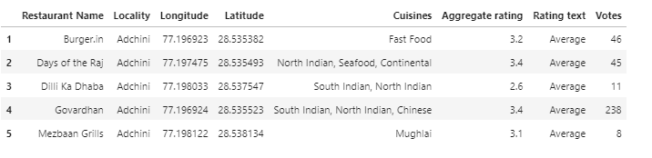
Data Extraction and cleaning
After understood a business problem and collected the data required to
start the analysis process using panda’s data frames cleaning plays a
crucial role, the data being acquired from kaggle dataset it is cleaned.

Slide 8
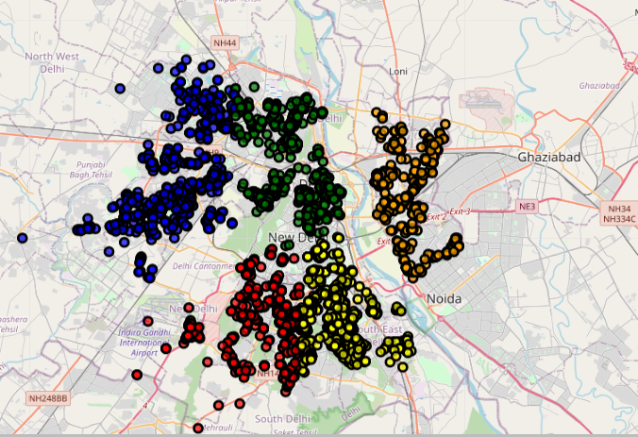
Exploratory Data Analysis: Creation of a map using Folium and displaying all the restaurants located in different areas of New Delhi. Used Foursquare API to get a list of all the locations of restaurants in New Delhi includes cafe shops, Pizza cafes and all other types of Restaurants.

Slide 9
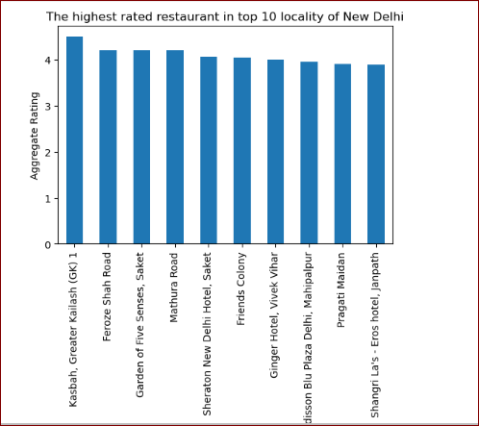

Slide 10
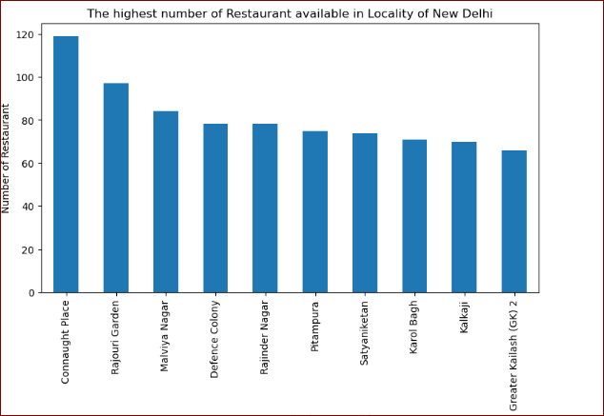

Slide 11
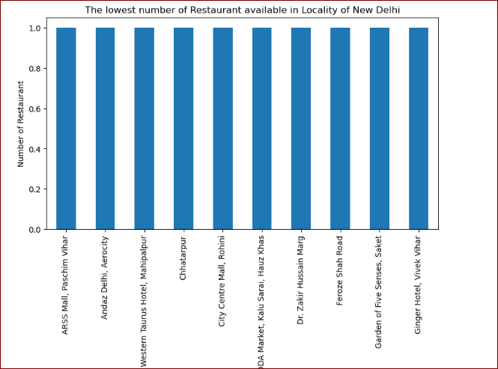

Slide 12
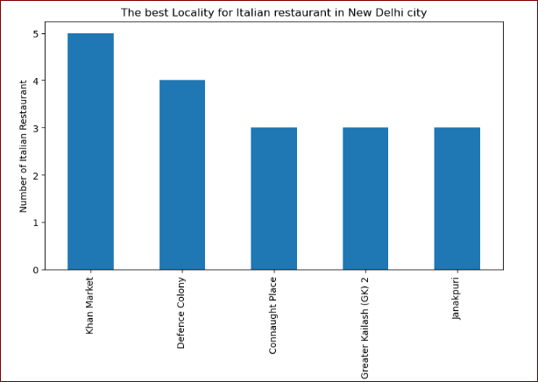

Slide 13
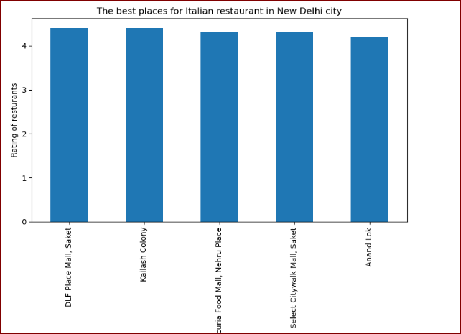

Slide 14
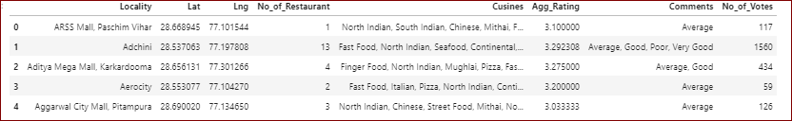
Data transformation

Slide 15
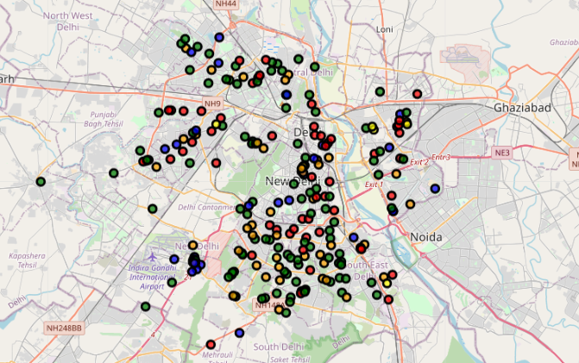
Creation of Folium map Then we created a map using the Folium package in Python and all restaurants were colored based on the cluster label

Slide 16
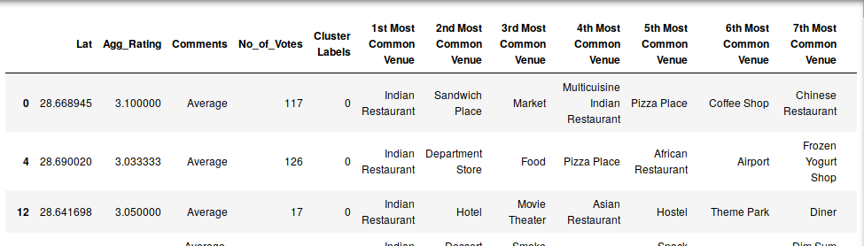
Cluster 1:
The Indian restaurants are most recommended venues nearby the locations.

Slide 17
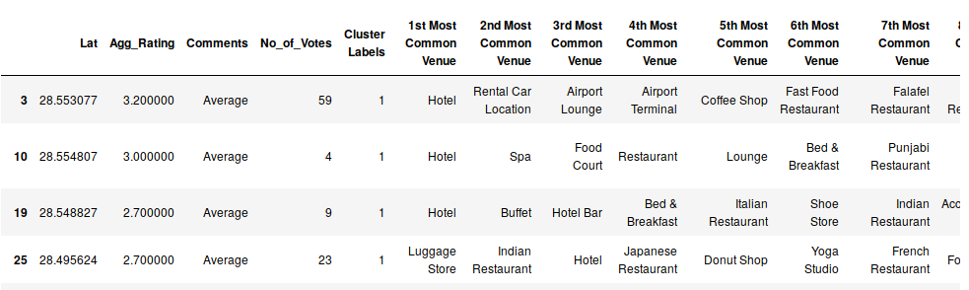
Cluster 2:
It is recommended for the Hotel and Nightclubs venues areas:

Slide 18
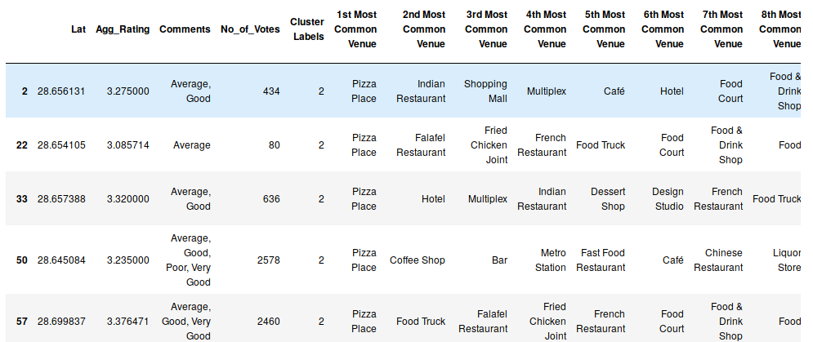
Cluster 3:
It seems like pizza place

Slide 19
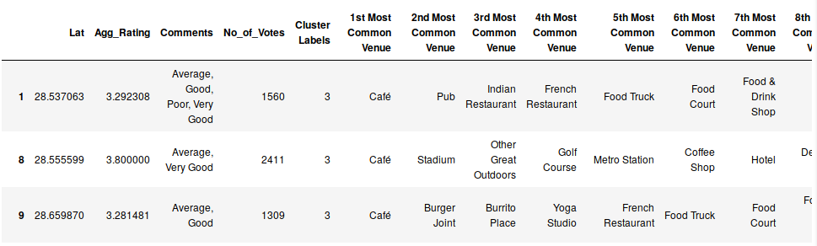
Cluster 4:
It’s most recommended for cafes

Slide 20
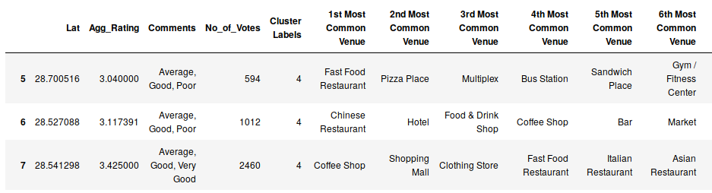
Cluster 5:
Fast food, cafes are the most recommended venues

Slide 21
Discussion and Result
Based on the cluster result below we can see that which cluster is recommended Indian restaurants, night clubs, Hotels, cafe, pizza, and fast food. As per the requirement of different people they can choose to live in the best suitable cluster.
As Delhi is one of the business hub in India, people are coming from different region of India as well as different countries. They can utilize the findings from this exercise and choose the best cluster to live in. This data contains most of the restaurants in Delhi with cuisines, ratings and location this will help all kind of food lovers.
Cluster 1: It is most recommended for Indian Restaurants.
Cluster 2: It is most recommended for Hotels and nightclub.
Cluster 3 and Cluster 5: It is most recommended for Fast food.
Cluster 4: It is most recommended for the cafe and pizza.

Slide 22
Conclusion
In conclusion, to end off this project, we had an opportunity on a business problem, and it was tackled in a way that it was similar to how a genuine data scientist would do. We utilized numerous Python libraries to fetch the information, control the content and break down and visualize those datasets.
We have utilized Foursquare API to investigate the settings in locations of restaurants in New Delhi, get a great measure of data from Kaggle. We visualized utilizing different plots present in Matplotlib libraries. Similarly, we utilized Folium to picture it on a map.
Khan Market and Defense Colony are some of the best neighborhoods for Italian cuisine.
DLF Place Mall, Saket and Kailash Colony** places have the best Italian restaurants
Greater kailash, Feroze shah road, Saket have best restaurants in New Delhi.

